Slide 1



Custom Copilot Chatbot for Expert Systems
Question & Answering

Slide 2
OVERVIEW
Abstract
Methodology
Introduction
Result
Problem
Conclusion
Objectives
Reference

Slide 3
ABSTRACT
Generative AI revolutionizes intelligent agents for natural language interaction, task automation, and decision-making.
Azure AI Studio enables rapid development of custom copilots for enterprises.
Combines LLMs, data connectivity, and deployment workflows for scalable, secure AI solutions.

Slide 4
INTRODUCTION
Cloud-based platform for building AI copilots.
Features:
Human-like interactions.
Contextual data retrieval.
Automated workflows.
Integrates Azure OpenAI, prompt engineering, and real-time data grounding.

Slide 5
PLATFORM OVERVIEW
Azure AI Studio Components:
LLM Access: GPT-4, Codex.
Prompt Flow: Visual conversational design.
Data Connectors: Enterprise knowledge integration.
Deployment Tools: Multi-channel (Teams, Web, APIs).
Monitoring: Dashboards for analytics and diagnostics.

Slide 6
KEY FEATURES
Prompt Flow:
Visual workflow builder for AI logic.
Data Grounding (RAG):
Enhances accuracy with enterprise data.
OpenAI Integration:
Customizable models (e.g., GPT-4).
Multi-Channel Deployment:
Teams, Web, Power Platform, APIs.
Monitoring & Governance:
Usage tracking, security controls, audit logs.

Slide 7
USE CASES
Enterprise Applications:
Customer Support: FAQ automation, case routing.
Knowledge Assistants: Instant document access.
Sales Copilots: CRM data, product specs.
Onboarding Agents: Employee guidance.

Slide 8

RESULT
Findings from Experimentation:
Rapid Prototyping: Copilot built in <1 day.
Accuracy: High relevance with data grounding.
Deployment: One-click to Teams/Web.
Security: Role-based access, compliance.
User Experience: Natural dialogue, intuitive navigation.

Slide 9
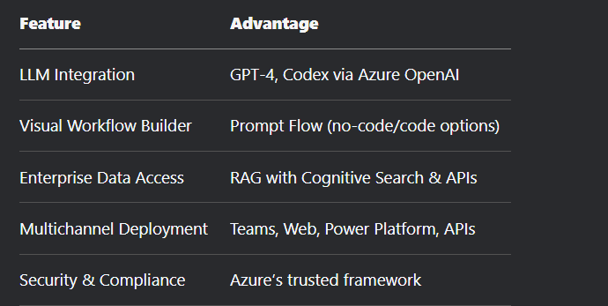
COMPETITIVE ADVANTAGES

Slide 10
DEVELOPMENT LIFECYCLE
Steps:
Define objectives.
Collect/integrate data.
Design prompts (Prompt Flow).
Test & simulate.
Deploy with security controls.
Monitor & iterate.

Slide 11
CONCLUSION
Azure AI Studio is a scalable, secure, and user-friendly platform for AI copilots.
Combines cutting-edge LLMs, data integration, and monitoring.
Ideal for automating workflows while maintaining compliance.

Slide 12
RECOMMENDATIONS
Developers: Use Prompt Flow for rapid testing.
IT Leaders: Secure deployments via Azure.
Business Units: Pilot high-impact tasks (e.g., support, sales).
Product Teams: Align AI capabilities with business needs.

Slide 13
REFERENCE
Microsoft Learn: Build a Copilot with Azure AI Studio.
Office Garage IT Pro: Build Your Own Copilots.
Propella.ai: Microsoft Copilot Studio vs Azure AI Studio.

Slide 14
Thank You
For your attention

